Slide 2
Learning to Forgive and Let Go
Notes:
Learning to Forgive - One of the hardest things that any of us can ever learn in life is how to forgive someone that has wronged us. How many of you know from experience that one of the most challenging emotions to express is forgiveness? For some of us here, we have been carrying around the weight of something that happened years, maybe even decades ago. Friends, I know that the struggle is real. For me, learning forgiveness has been one of my life goals. It has also been one of my greatest challenges.

Slide 3
1. What forgiveness is not?
Notes:
My prayer in this presentation is to answer three essential questions regarding the topic of forgiveness. I will also share some very practical steps that will be beneficial. What forgiveness is not? What forgiveness looks like? Why should I forgive?

Slide 4
2. What forgiveness looks like?
Notes:
What forgiveness looks like?

Slide 5
3. Why should I forgive?
Notes:
Why should I forgive?

Slide 6
Let all bitterness, wrath, anger, clamor, and evil speaking be put away from you, with all malice. And be kind to one another, tenderhearted, forgiving one another, even as God in Christ forgave you. - Ephesians 4:31, 32 NKJV
Notes:
The Apostle Paul tells us in Ephesians 4:31, 32: “Let all bitterness, wrath, anger, clamor, and evil speaking be put away from you, with all malice. And be kind to one another, tenderhearted, forgiving one another, even as God in Christ forgave you.” NKJV

Slide 7
Notes:
Looking in the rearview mirror of life on all the negative experiences you have had will cause you much pain in the present. So why does God ask us to let go of all bitterness and forgive one another? When someone has bitterness in their heart, they will always reckon back to the past. They will justify this by telling themselves; I can act this way today and speak these words today because of something that happened in the past. They are locked up in prison, and they cannot move forward with their life. It may be the year 2023,, but in their mind, they are still living in the past.

Slide 8
Not forgiving your critics is the burden of carrying their criticism with you.
Notes:
Not forgiving your critics is the burden of carrying their criticism with you.

Slide 9
Unforgiveness is allowing someone to live rent free in your brain.
Notes:
Unforgiveness is allowing someone to live rent free in your brain.

Slide 10
“Life is 10% what happens to you and 90% how you respond to it.” - Chuck Swindoll
Notes:
Chuck Swindoll said, “Life is 10% what happens to you and 90% how you respond to it.” Let’s start off by looking at what forgiveness is not.

Slide 11
What forgiveness is not?
Notes:
What forgiveness is not? When it comes to forgiveness, the most common definition is “forgive and forget.” I don’t particularly like this answer. When your world has been turned upside down by someone, how can you forget? Here is what happens to many people: They will choose in their hearts to forgive someone, but when they fail to forget, they think they have been unable to forgive. Just because you remember that someone wronged you does not mean you haven’t forgiven them.

Slide 12
The goal of forgiveness is to remember what happened to you in a different way.
Notes:
It’s normal to have forgiven someone, but have some lingering disquietude about the wrong that has taken place. The goal of forgiveness is to remember what happened to you in a different way (repeat this 2x).

Slide 13
Forgiveness does not mean accepting what was done to you. What happened to you was wrong.
Notes:
Forgiveness does not mean accepting what was done to you. What happened to you was wrong.

Slide 14
Forgiveness is not condoning someone’s behavior.
Notes:
Forgiveness is not condoning someone’s behavior.

Slide 15
Forgiveness is not making a past wrong right. It does not mean you have to be friends with the person that hurt you.
Notes:
Forgiveness is not making a past wrong right. It does not mean you have to be friends with the person that hurt you.

Slide 16
Forgiveness does not mean everything goes back to the way it was.
Notes:
Forgiveness does not mean everything goes back to the way it was.

Slide 17
When we forgive someone, we can still hold them accountable for their behavior while letting go of the impact that they had on your life.
Notes:
It is essential to understand that if someone wronged you, what they did to you is still wrong. Forgiveness does not excuse their behavior. When we forgive someone, we can still hold them accountable for their behavior while letting go of the impact that they had on your life.

Slide 18
Notes:
For example, if someone here experienced abuse by their spouse, by their parent or by someone else: When you chose to forgive that person that hurt you, it does not mean you have to stay in a relationship with that individual. Please do not forget what I am about to tell you. Forgiveness does not mean you will be reconciled to the one that hurt you. The Gospel in the Bible teaches that Jesus offers forgiveness to everyone, but not all are reconciled to God.

Slide 19
If we confess our sins, He is faithful and just to forgive us our sins and to cleanse us from all unrighteousness. - 1 John 1:9 NKJV
Notes:
The Bible tells us in 1 John 1:9, “If we confess our sins, He is faithful and just to forgive us our sins and to cleanse us from all unrighteousness.” NKJV

Slide 20
Let all bitterness, wrath, anger, clamor, and evil speaking be put away from you, with all malice. And be kind to one another, tenderhearted, forgiving one another, even as God in Christ forgave you. - Ephesians 4:31, 32 NKJV
Notes:
Remember the passage we looked at in Ephesians 4:31, 32: “Let all bitterness, wrath, anger, clamor, and evil speaking be put away from you, with all malice. And be kind to one another, tenderhearted, forgiving one another, even as God in Christ forgave you.” NKJV

Slide 21
Notes:
When it comes to our relationships, please know that when you have been wronged, trust is broken. Forgiveness and trust are two different things.

Slide 22
Forgiveness is free. Trust is earned.
Notes:
Forgiveness is free. Trust is earned. When you chose to forgive someone, this does not mean that you will ever trust them again.

Slide 23
What forgiveness looks like?
Notes:
What forgiveness looks like? Forgiveness is about moving forward, not looking back, and living in the past. Back in the 1950s, athletes from around the world tried to run the 4-minute mile. It was called the miracle mark. Nobody ever thought it was possible. Then in 1954, a man from England named Roger Banister broke the 4 minute mile. Soon after that, John Landy did the same. Roger and John decided to race in Vancouver BC to see who could be the fastest mile runner.

Slide 24
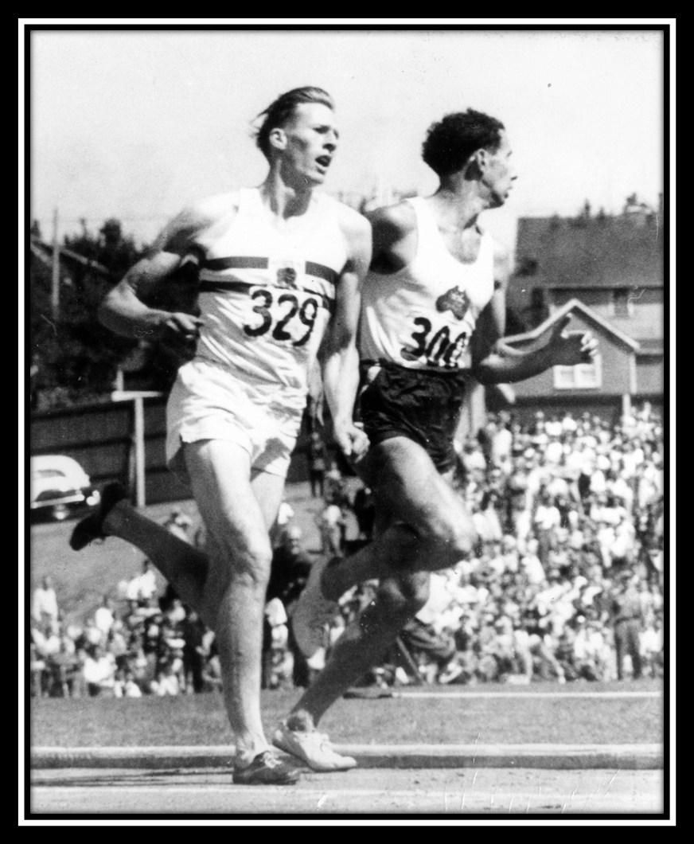
Notes:
John Landy was leading the first three laps. On the final lap, John Landy looked behind to see where Roger Banister was. In doing so, Roger Bannister sprinted around the other side and won the race.

Slide 25
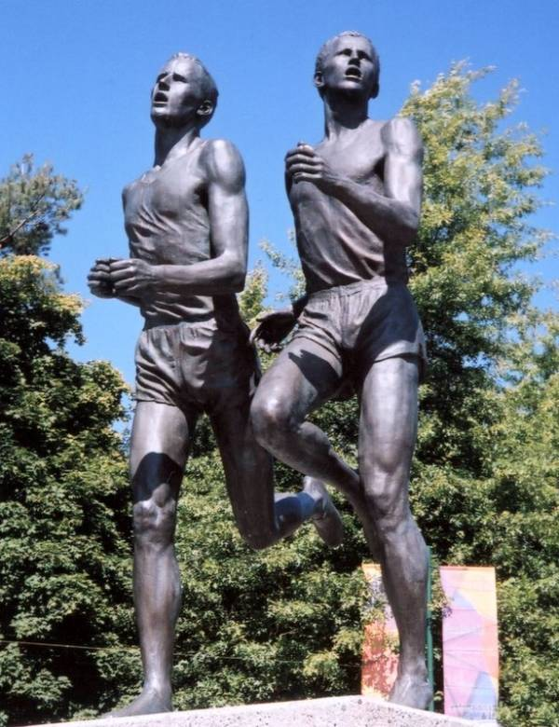
Notes:
The act of looking behind, when he should have been looking ahead, was memorialized in a bronze statue. John Landey said, “When Lot’s wife looked back, she turned into a pillar of salt; when I looked back they made me into a pillar of bronze. (Side note - The statue is located in Hastings Park in Vancouver, BC.)

Slide 26
Forgiveness is giving up the hope that the past will be any different.
Notes:
The secret to finding true happiness will not take place if we continue to focus on what is behind by ruminating on the past. The absolute best definition for forgiveness is Forgiveness is giving up the hope that the past will be any different. (Repeat) Forgiveness is about letting go so that the past does not hold you prisoner. We all need forgiveness and we need to give it. The real payoff of forgiveness is that you deserve to stop suffering for what others have done to you.

Slide 27
Forgiveness is giving up the hope that the past will be any different.
Notes:
Forgiveness happens when we change our perception about the person that wronged us. Forgiveness is all about our perception of the other person. When we are hurt, we can either personalize it, or we can depersonalize it. When I depersonalize an event, I tell myself, “That is how the other person is, it’s just the way they are.”

Slide 28
Then Jesus said, “Father, forgive them, for they do not know what they do. - Luke 23:34 NKJV
Notes:
When Jesus was hanging on the cross, and the Roman soldiers were taunting Him, do you remember what Jesus prayed? It is recorded in Luke 23:34, “Then Jesus said, “Father, forgive them, for they do not know what they do.”

Slide 29
Then Jesus said, “Father, forgive them, for they do not know what they do. - Luke 23:34 NKJV
Notes:
Jesus was able to change the circumstance by depersonalizing the event. The question for us here is: do we trust God to make all things right, or will we take it upon ourselves to correct any wrongs? I say we trust God; what about you?

Slide 30
Hurting people hurt other people.
Notes:
Remember, hurting people hurt other people. It is helpful to see through the eyes of empathy and know that those that hurt you are also in pain. What I have personally found very helpful is to see the world through the other person’s eyes. (Seminar Note: Share a personal story of how you had to practice forgiveness. Story of my father and the anger I had towards him. When I begin to see the pain that had been inflicted upon him by my grandfather, I couldn’t help but sympathize and feel an overwhelming sense of compassion toward him.)

Slide 31
Notes:
There may be times in your life when you feel like you have gotten past something, and then something happens, and you are reminded of the event. Something triggers those memories, and all of those old feelings begin to come back. The hurt, the anger, the heartache all come back, and we ask ourselves, “How do I let this go?” I want to move on from this, but it seems too hard. How many of you have ever experienced this?

Slide 32
Notes:
One of the best ways to let something go is by killing that person. Let me rephrase that: killing that person with kindness. Please know that every situation is different. If you are in an abusive relationship, then you need to distance yourself for your safety. When I talk about killing someone with kindness, I am talking about the annoying coworker or cantankerous neighbor.

Slide 33
Kindness Kills Bitterness
Notes:
Our natural feeling is to get even, right? Remember: Kindness Kills Bitterness (Repeat).

Slide 34
Do not be overcome by evil, but overcome evil with good. - Romans 12:21 NKJV
Notes:
Paul tells us in Romans 12:21, “Do not be overcome by evil, but overcome evil with good.” NKJV Systematic kindness starves un-forgiveness. When a person has bitterness, and they don’t want to forgive someone, they, in turn, will find it hard to repent of their sins.

Slide 35
And forgive us our debts, As we forgive our debtors. - Matthew 6:12 NKJV
Notes:
Jesus tells us in Matthew 6:12, “And forgive us our debts, As we forgive our debtors.” You see, repentance and forgiveness are intertwined. The two active ingredients to the Christian life are repentance towards God and forgiveness towards others. It is impossible to carry bitterness and still have a spirit-filled life. It is impossible.

Slide 36
Notes:
I heard the story about a Christian lady that was so angry at her mother for a rough childhood that she said, “I hope my mother goes to hell.” Let me ask you, is this Christian lady ready to go to heaven with that kind of an attitude?

Slide 37
Why should I forgive?
Notes:
Why should I forgive?

Slide 38
“To forgive is to set a prisoner free and discover that the prisoner was you.”
- Lewis B. Smedes
Notes:
Lewis B. Smedes said, “To forgive is to set a prisoner free and discover that the prisoner was you.”

Slide 39
“The first to apologize is the bravest. The first to forgive is the strongest. The first to forget is the happiest.”
- unknown author
Notes:
An unknown author wrote, “The first to apologize is the bravest. The first to forgive is the strongest. The first to forget is the happiest.”

Slide 40
If you wait for the other person to apologize and admit they were wrong, you are tying your healing to a decision that the other person may never make.
Notes:
Forgiveness is not for the other person, it is to help you sever the suffering. If you wait for the other person to apologize and admit they were wrong, you are tying your healing to a decision that the other person may never make.

Slide 41
But I say to you, love your enemies, bless those who curse you, do good to those who hate you, and pray for those who spitefully use you and persecute you. - Matthew 5:44 NKJV
Notes:
Notice what Jesus tells us in Matthew 5:44 – But I say to you, love your enemies, bless those who curse you, do good to those who hate you, and pray for those who spitefully use you and persecute you.” NKJV

Slide 42
…that you may be sons of your Father in heaven… - Matthew 5:45 NKJV
Notes:
The best way to survive persecution and unkindness is to do good back. This is the remedy, and it is the solution. Notice that the passage continues by saying in V45 “that you may be sons of your Father in heaven…”

Slide 43
For as many as are led by the Spirit of God, these are sons of God. - Romans 8:14 NKJV
Notes:
So let me ask you, Are we all the children of God naturally, or do we need to be born again by his Spirit? Paul tells us in Romans 8:14 – “For as many as are led by the Spirit of God, these are sons of God.” NKJV

Slide 44
Blessed are the peacemakers, For they shall be called sons of God. - Matthew 5:9 NKJV
Notes:
In the Sermon on the Mount, Jesus says, “Blessed are the peacemakers, For they shall be called sons of God.” Matthew 5:9 NKJV When you do an act of kindness to someone unkind to you, you are performing the role of a peacemaker. If someone is running around the church, stirring up strife, unhappiness, and gossip, are they a peacemaker? No way. If someone is bent on revenge, getting even, they cannot call themselves the child of heaven. The peacemakers are those who are exemplifying the character of our Heavenly Father.

Slide 45
Notes:
How do we react when someone says something or does something unkind? Do we get flustered, angry, seek revenge, gossip? If the smallest thing sets us off and we lose our Christian experience, we need to ask ourselves, am I living in Christ? What is our Christian experience like?

Slide 46
Notes:
Maybe someone had suffered abuse when they were younger. Do you know why they should forgive? If they do not forgive, that abuse will continue in some way. In other words, it may have been physical at one time, but now it is emotional. If they don’t forgive, they will live it over and over again. That physical abuse that has now turned emotional will not go away until we learn to forgive.

Slide 47
Notes:
Please know, when I say you should forgive, I am not saying what happened to you was OK. I am not saying you should remain in an abusive relationship or a dangerous situation. You can forgive because forgiveness sets you free. You have gone through some terrible things. Your experience was something that you did NOT deserve, and that person that abused you may still be that terrible monster. By forgiving, you can start again.

Slide 48
Notes:
Some think forgiveness happens after the person that hurt you has learned their lesson that you think they need to learn or have had true repentance with tears running down their face. Don’t wait until you have evidence that they have suffered as much as you had suffered. There will never be the perfect day when all of this happens so that you can magically forgive.

Slide 49
Notes:
Let’s all think about this rationally and ask yourself, which is harder?

Slide 50
1. To do kindness for someone unkind to you and, in doing that, live in peace about that situation for the rest of your life.
Notes:
1. Let’s all think about this rationally and ask yourself, which is harder?

Slide 51
2. Not do anything, don’t forgive and suffer the emotional, psychological, and even the social, physical consequences for the rest of your life.
Notes:
2. Not do anything, don’t forgive and suffer the emotional, psychological, and even the social, physical consequences for the rest of your life. Which is harder when you look at it from this point of view? Let’s get practical and talk about how to work through the process of forgiveness. Notice I said process. When it comes to those deep wounds, learning to forgive is a process.

Slide 52
How can I forgive?
Notes:
How can I forgive? Remember, friends, bitterness and resentment stop your life. Why? Because you end up living in the past.

Slide 53
1. Forgiveness is giving up the hope that the past will be any different.
Notes:
Here is what has helped me work through the process of forgiveness in my life. 1. Forgiveness is giving up the hope that the past will be any different.

Slide 54
Brethren, I do not count myself to have apprehended; but one thing I do, forgetting those things which are behind and reaching forward to those things which are ahead. - Philippians 3:13 NKJV
Notes:
Ruminating on the past and what you could have or should have done differently will only frustrate you more. I love what Paul says in Philippians 3:13, “Brethren, I do not count myself to have apprehended; but one thing I do, forgetting those things which are behind and reaching forward to those things which are ahead.” NKJV

Slide 55
Brethren, I do not count myself to have apprehended; but one thing I do, forgetting those things which are behind and reaching forward to those things which are ahead. - Philippians 3:13 NKJV
Notes:
Some have found it helpful to write a letter to the person that wronged you. In the letter, you pour your heart out, and then you burn the letter. You don’t mail it, but you burn it. By writing this letter, you are releasing the hurt and pain and telling the person how you feel. Again, this is about your emotional healing.

Slide 56
2. Remember, hurting people hurt other people.
Seeing through the eyes of empathy.
Notes:
2. Remember, hurting people hurt other people. Seeing through the eyes of empathy you know that those that hurt you are also in pain. Try examining the world through the eyes of the person that hurt you. If someone sexually abused you as a child, there is an unfortunate chance that they too experienced similar abuse. This in no way excuses what they did. What it does is help give empathy towards that person. This helps you heal from the damage. (Speaker Note: Share about a scar on your body. The scar remains, but the pain is gone.)

Slide 57
3. The person who hurt you may not know the extent of the hurt they caused.
Notes:
3. The person who hurt you may not know the degree in which they hurt you. On a scale of 1-10, with a 10 being the absolute worst thing that could happen, think about where you would place your level of hurt. Would it be a 5, a 7, or maybe a 9? What if your hurt level was an 8, but the person that wronged you placed what they did to you at a 2 or a 3? Most people who have wronged someone place what they did at a lower level than the individual who experienced the wrongful act. This discrepancy can explain why the person who hurt you doesn’t show the level of sorrow that you are expecting. Does this make sense?

Slide 58
To not forgive is like drinking rat poison and hoping the rat dies.
Notes:
When the person that wronged us apologizes, it helps us heal and experience forgiveness. What happens when the person that wounded you does not apologize? Maybe they don’t realize how deeply they hurt you? Their level of apology and what we think we are owed is not the same number. Remember, learning to forgive, whether you ever receive an apology or not helps you to move on with your life. To not forgive is like drinking rat poison and hoping the rat dies. The person who wronged us could be oblivious to the fact that we are upset with them.

Slide 59
4. Consider who has forgiven more? God toward us for what we have done or what someone has done to me?
Notes:
4. Consider who has forgiven more? God toward us for what we have done or what someone has done to me?

Slide 60
Matthew 18:23-29
Notes:
In Matthew 18, Jesus tells the story of forgiveness. In the story a servant owed his master 10,000 talents. 10k talents = enough silver to hire 10,000 laborers for 18 years. The servant promises to repay the king, however the servant has no clue of the size of his debt. The king has compassion on him and forgave his debt.

Slide 61
10,000 talents vs 100 denarii
Notes:
As the servant was heading home, he found someone who owed him 100 denarii. A denarius represented one day's wage for a common laborer, so this was not a small amount. However, when compared to the amount that the man had just been forgiving, it was. Consider this, the servant who has just been forgiven a debt that he could never repay, has the temerity to demand that this “someone” repay him 100 denarii.

Slide 62
10,000 talents vs 100 denarii
Notes:
This ratio is like comparing the distance of the earth to the sun vs. earth to the moon. Here is the point – When we don’t understand the enormity of our “debt” and the price paid for our redemption, we don’t appreciate the offer of grace and act graceless towards others. Ask yourself these questions. Who has forgiven more? God towards us for what we have done or what someone has done to me?

Slide 63
10,000 talents vs 100 denarii
Notes:
Later on in story the Bible says the man was delivered to the prison. This is where we end up. When we hold onto bitterness, cynicism in our hearts, we are in a spiritual and emotional prison.

Slide 64
Forgiveness Heals Us
Notes:
In Mark 2, there is a story of the paralytic that was lowered through the roof into a house by his friends so that he can see Jesus. The house was so crowded that the only way to get that man to Jesus was to lower him through the roof. Their faith so moved Jesus that He not only healed the man, but he forgave the man’s sins. Jesus linked forgiveness with healing. There is a connection between forgiveness and a person’s physical health.

Slide 65
Spiritually – Our relationship with God. We appreciate the forgiveness Jesus offers us.
Notes:
Spiritually – Our relationship with God. We appreciate the forgiveness Jesus offers us.

Slide 66
Physically –Holding onto anger raised your blood pressure.
Notes:
Physically –Holding onto anger raised your blood pressure.

Slide 67
Emotionally – Anger and bitterness that I carry with me can lead to depression and anxiety.
Notes:
Emotionally – Anger and bitterness that I carry with me can lead to depression and anxiety.

Slide 68
Jesus knows that the human heart was not created to carry the weight of unforgiveness.
Notes:
Jesus knows that the human heart was not created to carry the weight of unforgiveness. The heavy weight of unforgiveness is the weight of anxiety and fear. You deserve to stop suffering for what others have done to you.

Slide 69
Notes:
I would like to close with the story of two Vietnam POWs that were visiting the Vietnam Memorial in Washington DC. One of the men asked the other, have you been able to forgive your captors? The man responded with an angry tone, “How can I?” The man who asked the questions said: “Then they still have you in captivity.”

Slide 70
In the name of Jesus and by the power of His blood, I purpose and choose to forgive [person or situation]. I cancel this debt to me and release [person or situation]. Holy Spirit, come bring your healing and your truth. In Jesus name, amen.
Notes:
Forgiveness is God’s gift. Here is an example if a prayer that a friend shared with me: In the name of Jesus and by the power of His blood, I purpose and chose to forgive [person or situation]. I cancel this debt to me and release [person or situation]. Holy Spirit, come bring your healing and your truth. In Jesus name, amen.

Slide 71
Notes:
The person that hurt you did not stop you, they propelled you. It is time to severe your suffering by choosing to forgive. It is your choice, you have the right to make this decision. This decision is not based on if the person that hurt you has changed, it is based on that fact that you have changed.
What happened to you matters. I want you to know that I bear witness to your pain. I want you to know that I am sorry for what happened to you. Now, I want you to be brave and courageous and set free from all of that pain. Any remaining feeling that you have towards that person, can be covered by the blood of Jesus. This is your moment, and it is time to close that chapter of your life and start your next chapter. You have within you creativity, love, passion, a new beginning and I declare over your life that you will flourish.

Slide 72
1. Why do we refer to forgiveness as a process? 2. Why should we forgive a person that hurt you? 3. How does forgiveness benefit you? 4. What practical ways have helped you learn to forgive?
Notes:
Please be sure to meet in your life groups and go through the discussion questions up on the screen.

